Slide 1



A Tutorial on Adversarial Robustness

Slide 2


Why Adversarial Robustness?
Adversarial input
Contested environments
Notes:
Let’s start by breaking down each of the terms in the title. To understand the sliding window model, we first have to understand the streaming model of computation, in which elements of an underlying data set S, arrive sequentially and the goal is to evaluate or approximate some given function on this dataset, using space sublinear in S. In the sliding window model, only the W most recent updates form the underlying data set

Slide 3
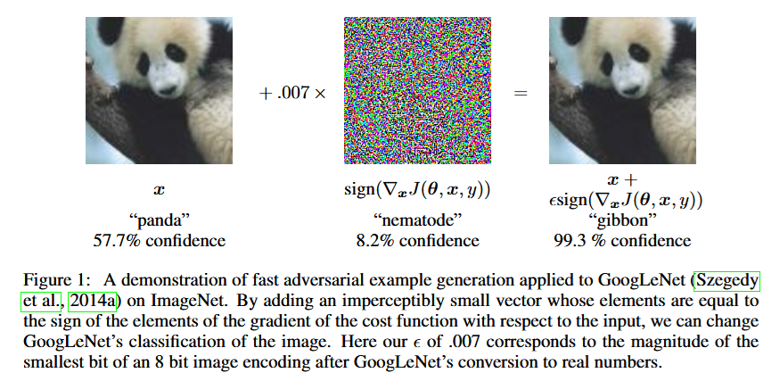
Why Adversarial Robustness?
Adversarial input
Adversarial ML
Notes:
Let’s start by breaking down each of the terms in the title. To understand the sliding window model, we first have to understand the streaming model of computation, in which elements of an underlying data set S, arrive sequentially and the goal is to evaluate or approximate some given function on this dataset, using space sublinear in S. In the sliding window model, only the W most recent updates form the underlying data set

Slide 4
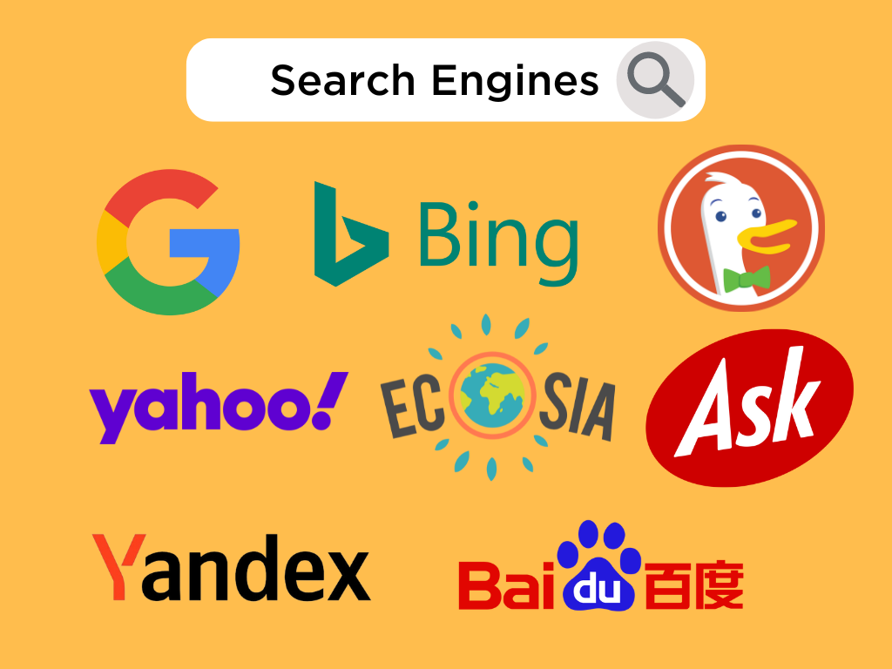
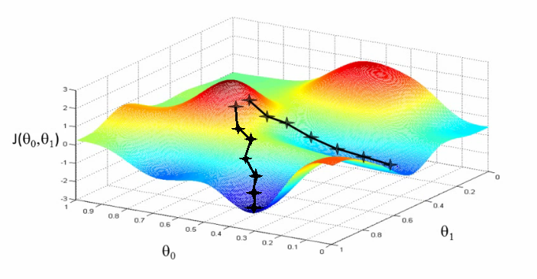

Why Adversarial Robustness?
Adaptive input
Repeated interactions
Database Queries
Stochastic Optimization
Financial Analytics
Notes:
Let’s start by breaking down each of the terms in the title. To understand the sliding window model, we first have to understand the streaming model of computation, in which elements of an underlying data set S, arrive sequentially and the goal is to evaluate or approximate some given function on this dataset, using space sublinear in S. In the sliding window model, only the W most recent updates form the underlying data set

Slide 5
Why Adversarial Robustness?
Connections across many areas:
Sublinear algorithms
Graph theory
Functional analysis
Information theory
Differential privacy and adaptive data analysis
Cryptography
Notes:
Let’s start by breaking down each of the terms in the title. To understand the sliding window model, we first have to understand the streaming model of computation, in which elements of an underlying data set S, arrive sequentially and the goal is to evaluate or approximate some given function on this dataset, using space sublinear in S. In the sliding window model, only the W most recent updates form the underlying data set

Slide 6
Sampling and Adversarial Input
Notes:
Let’s start by breaking down each of the terms in the title. To understand the sliding window model, we first have to understand the streaming model of computation, in which elements of an underlying data set S, arrive sequentially and the goal is to evaluate or approximate some given function on this dataset, using space sublinear in S. In the sliding window model, only the W most recent updates form the underlying data set

Slide 7
Workshop Themes
Notes:
Let’s start by breaking down each of the terms in the title. To understand the sliding window model, we first have to understand the streaming model of computation, in which elements of an underlying data set S, arrive sequentially and the goal is to evaluate or approximate some given function on this dataset, using space sublinear in S. In the sliding window model, only the W most recent updates form the underlying data set

Slide 8

Model #1: Streaming Model
Input: Elements of an underlying data set $S$, which arrives sequentially
Output: Evaluation (or approximation) of a given function
Goal: Use space sublinear in the size $m$of the input $S$
1 0 1 1 1 0 0 1
Notes:
Let’s start by breaking down each of the terms in the title. To understand the sliding window model, we first have to understand the streaming model of computation, in which elements of an underlying data set S, arrive sequentially and the goal is to evaluate or approximate some given function on this dataset, using space sublinear in S. In the sliding window model, only the W most recent updates form the underlying data set

Slide 9
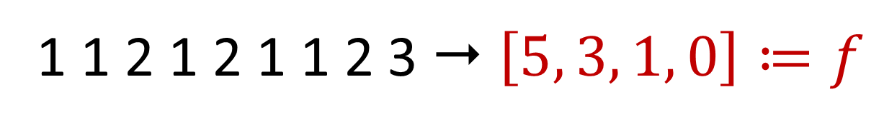

Frequency Vector
Given a set $S$ of $m$ elements from $[n]$, let $f_{i}$ be the frequency of element $i$. (How often it appears)
1 1 2 1 2 1 1 2 3  $\left[5, 3, 1, 0\right]≔f$

Slide 10
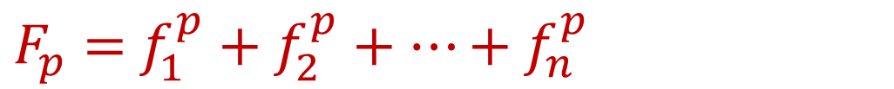
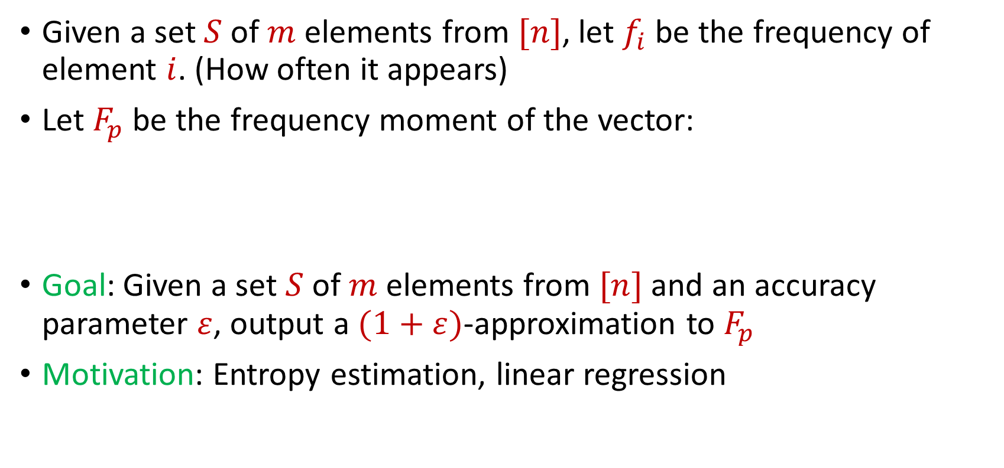
Frequency Moments
Given a set $S$ of $m$ elements from $[n]$, let $f_{i}$ be the frequency of element $i$. (How often it appears)
Let $F_{p}$ be the frequency moment of the vector:
Goal: Given a set $S$ of $m$ elements from $[n]$ and an accuracy parameter $ε$, output a $(1+ε)$-approximation to $F_{p}$
Motivation: Entropy estimation, linear regression
$F_{p}=$ $f_{1}^{p}+f_{2}^{p}+…+f_{n}^{p}$

Slide 11
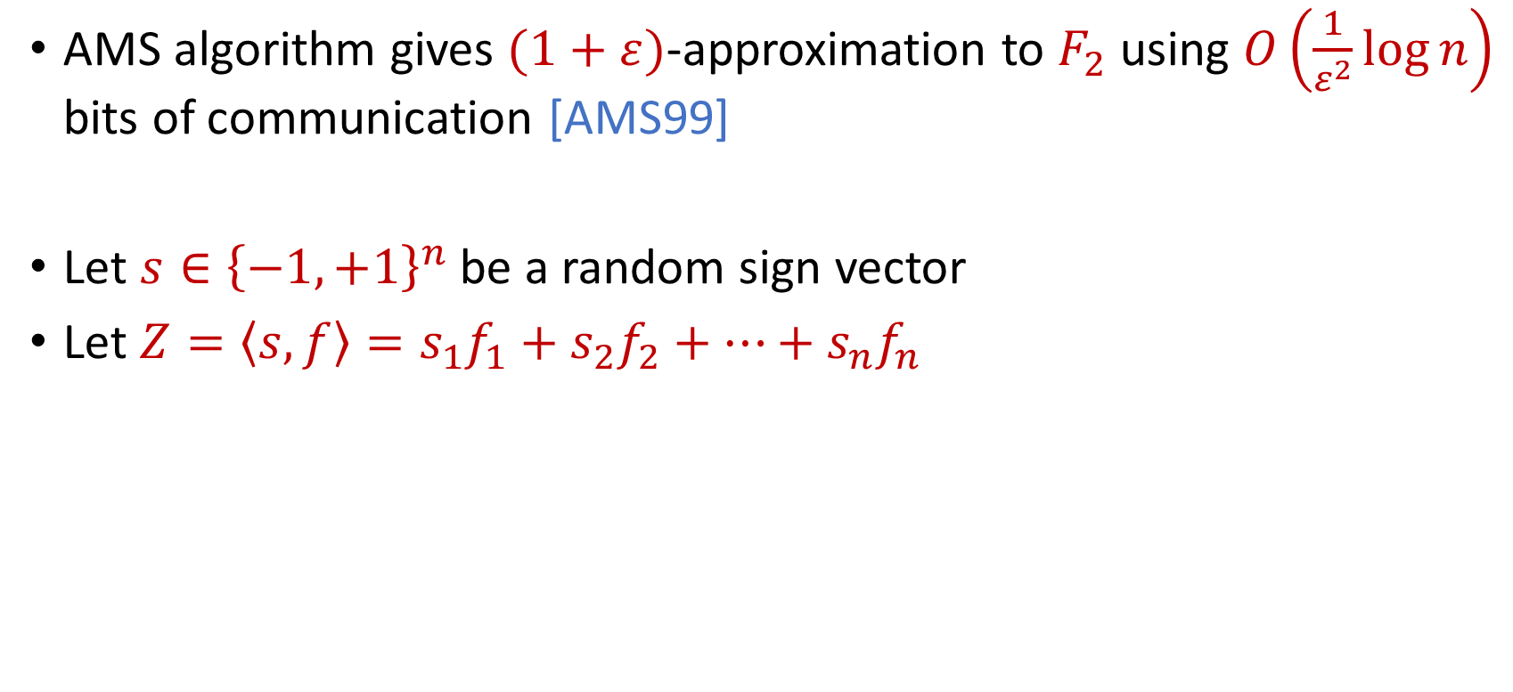
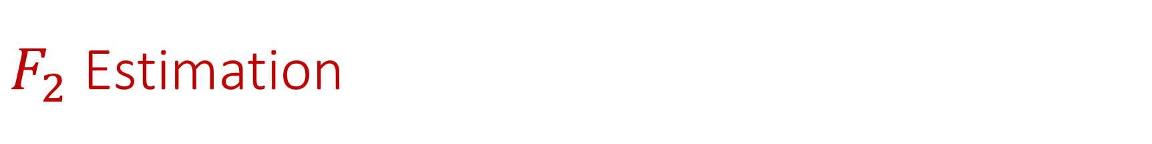
$F_{2}$ Estimation
AMS algorithm gives $(1+ε)$-approximation to $F_{2}$ using $O\left(\frac{1}{ε^{2}}\log{n}\right)$ bits of communication [AMS99]
Let $s∈{\left\{−1,+1\right\}}^{n}$ be a random sign vector
Let $Z=\left\langle s,f\right\rangle =s_{1}f_{1}+s_{2}f_{2}+…+s_{n}f_{n}$

Slide 12
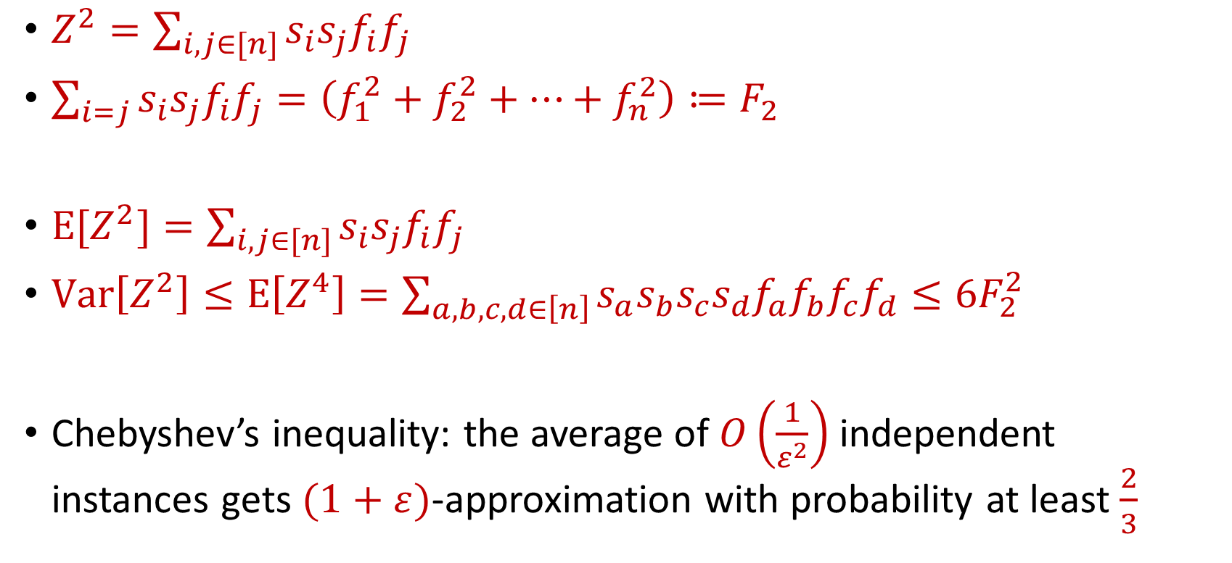
$F_{2}$ Estimation
$Z^{2}=\sum_{i,j∈[n]}{s_{i}s_{j}f_{i}f_{j}}$
$\sum_{i=j}{s_{i}s_{j}f_{i}f_{j}}=\left(f_{1}^{2}+f_{2}^{2}+…+f_{n}^{2}\right)≔F_{2}$
$E[Z^{2}]=\sum_{i,j∈[n]}{s_{i}s_{j}f_{i}f_{j}}$
$Var\left[Z^{2}\right]≤E\left[Z^{4}\right]=\sum_{a,b,c,d∈\left[n\right]}{s_{a}s_{b}s_{c}s_{d}f_{a}f_{b}f_{c}f_{d}}≤6F_{2}^{2}$
Chebyshev’s inequality: the average of $O\left(\frac{1}{ε^{2}}\right)$ independent instances gets $(1+ε)$-approximation with probability at least $\frac{2}{3}$

Slide 13
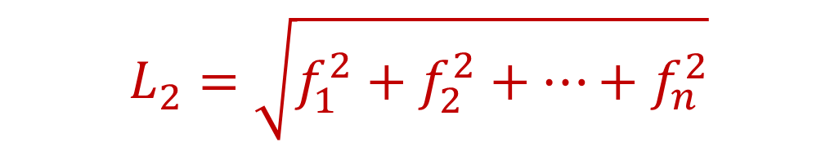
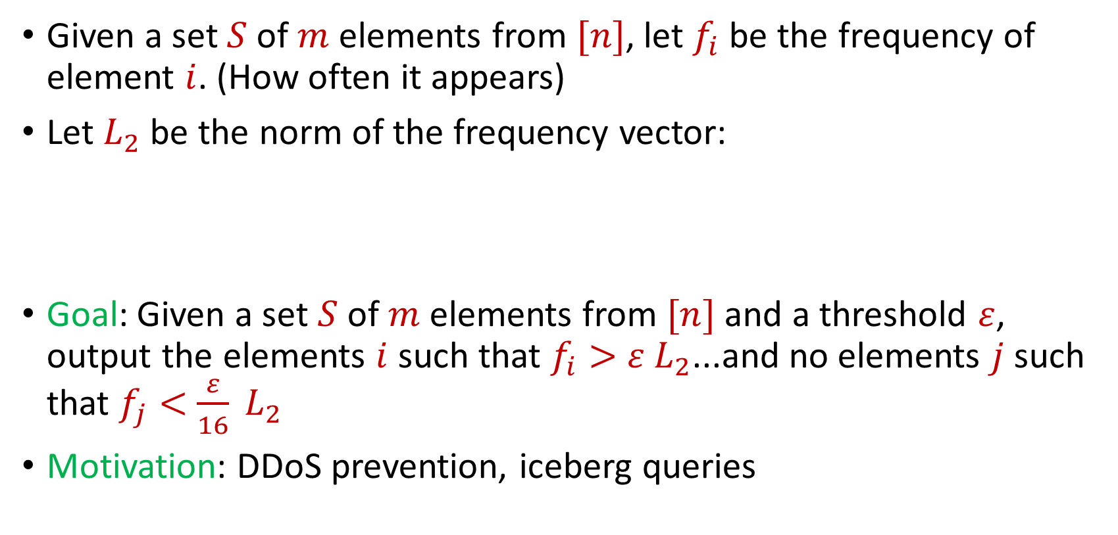
Heavy-Hitters
Given a set $S$ of $m$ elements from $[n]$, let $f_{i}$ be the frequency of element $i$. (How often it appears)
Let $L_{2}$ be the norm of the frequency vector:
Goal: Given a set $S$ of $m$ elements from $[n]$ and a threshold $ε$, output the elements $i$ such that $f_{i}>$ $ε L_{2}$...and no elements $j$ such that $f_{j}<$ $\frac{ε}{16} L_{2}$
Motivation: DDoS prevention, iceberg queries
$$L_{2}=\sqrt{f_{1}^{2}+f_{2}^{2}+…+f_{n}^{2}}$$

Slide 14
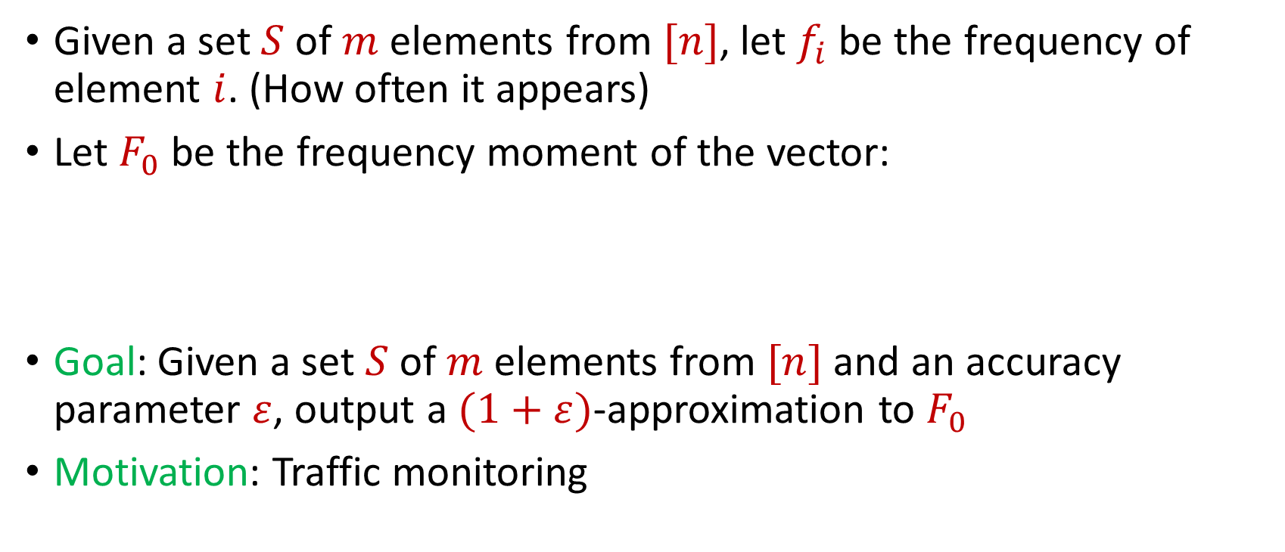
Distinct Elements
Given a set $S$ of $m$ elements from $[n]$, let $f_{i}$ be the frequency of element $i$. (How often it appears)
Let $F_{0}$ be the frequency moment of the vector:
Goal: Given a set $S$ of $m$ elements from $[n]$ and an accuracy parameter $ε$, output a $(1+ε)$-approximation to $F_{0}$
Motivation: Traffic monitoring
$F_{0}=$ $|\{i :f_{i}≠0\}|$

Slide 15
More generally…
Subspace embeddings, regression, low-rank approximation, clustering, etc.
(Can be handled by sampling algorithms)

Slide 16
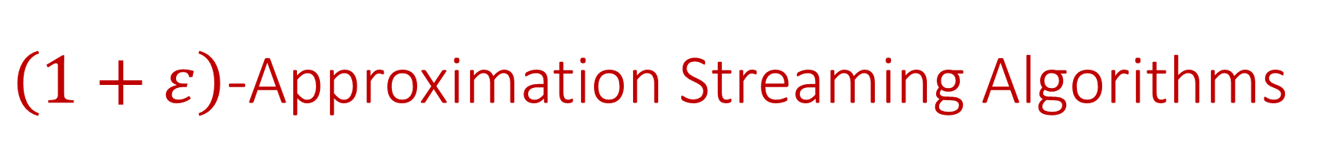
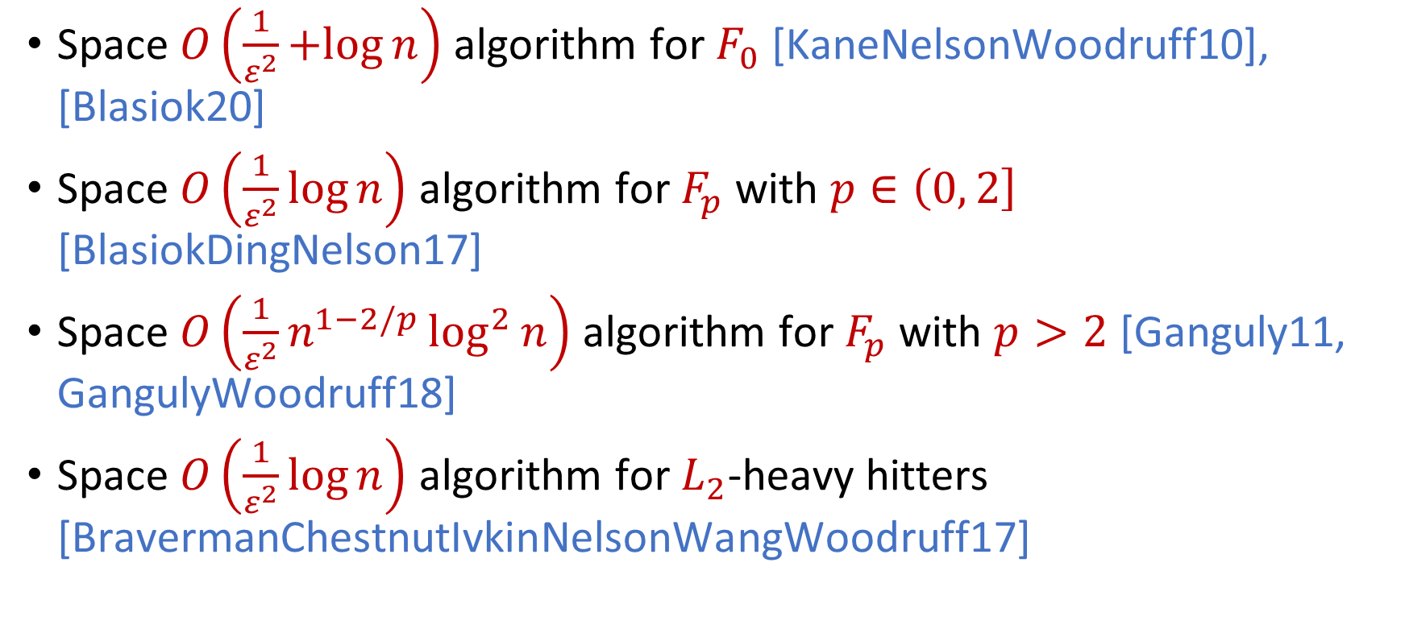
$\left(1+ε\right)$-Approximation Streaming Algorithms
Space $O\left(\frac{1}{ε^{2}}+log{n}\right)$ algorithm for $F_{0}$ [KaneNelsonWoodruff10], [Blasiok20]
Space $O\left(\frac{1}{ε^{2}}\log{n}\right)$ algorithm for $F_{p}$ with $p∈\left(0, 2\right]$ [BlasiokDingNelson17]
Space $O\left(\frac{1}{ε^{2}}n^{1−2/p}\log^{2}{n}\right)$ algorithm for $F_{p}$ with $p>2$ [Ganguly11, GangulyWoodruff18]
Space $O\left(\frac{1}{ε^{2}}\log{n}\right)$ algorithm for $L_{2}$-heavy hitters [BravermanChestnutIvkinNelsonWangWoodruff17]

Slide 17



Model #2: Adversarially Robust Streaming
Input: Elements of an underlying data set $S$, which arrives sequentially and adversarially
Output: Evaluation (or approximation) of a given function
Goal: Use space sublinear in the size $m$of the input $S$
1
1
Notes:
Let’s start by breaking down each of the terms in the title. To understand the sliding window model, we first have to understand the streaming model of computation, in which elements of an underlying data set S, arrive sequentially and the goal is to evaluate or approximate some given function on this dataset, using space sublinear in S. In the sliding window model, only the W most recent updates form the underlying data set

Slide 18
Model #2: Adversarially Robust Streaming
Input: Elements of an underlying data set $S$, which arrives sequentially and adversarially
Output: Evaluation (or approximation) of a given function
Goal: Use space sublinear in the size $m$of the input $S$
10
1
Notes:
Let’s start by breaking down each of the terms in the title. To understand the sliding window model, we first have to understand the streaming model of computation, in which elements of an underlying data set S, arrive sequentially and the goal is to evaluate or approximate some given function on this dataset, using space sublinear in S. In the sliding window model, only the W most recent updates form the underlying data set

Slide 19
Model #2: Adversarially Robust Streaming
Input: Elements of an underlying data set $S$, which arrives sequentially and adversarially
Output: Evaluation (or approximation) of a given function
Goal: Use space sublinear in the size $m$of the input $S$
101
2
Notes:
Let’s start by breaking down each of the terms in the title. To understand the sliding window model, we first have to understand the streaming model of computation, in which elements of an underlying data set S, arrive sequentially and the goal is to evaluate or approximate some given function on this dataset, using space sublinear in S. In the sliding window model, only the W most recent updates form the underlying data set

Slide 20
Model #2: Adversarially Robust Streaming
Input: Elements of an underlying data set $S$, which arrives sequentially and adversarially
Output: Evaluation (or approximation) of a given function
Goal: Use space sublinear in the size $m$of the input $S$
1010
3
Notes:
Let’s start by breaking down each of the terms in the title. To understand the sliding window model, we first have to understand the streaming model of computation, in which elements of an underlying data set S, arrive sequentially and the goal is to evaluate or approximate some given function on this dataset, using space sublinear in S. In the sliding window model, only the W most recent updates form the underlying data set

Slide 21

Model #2: Adversarially Robust Streaming
Input: Elements of an underlying data set $S$, which arrives sequentially and adversarially
Output: Evaluation (or approximation) of a given function
Goal: Use space sublinear in the size $m$of the input $S$
1010
3
Notes:
Let’s start by breaking down each of the terms in the title. To understand the sliding window model, we first have to understand the streaming model of computation, in which elements of an underlying data set S, arrive sequentially and the goal is to evaluate or approximate some given function on this dataset, using space sublinear in S. In the sliding window model, only the W most recent updates form the underlying data set

Slide 22
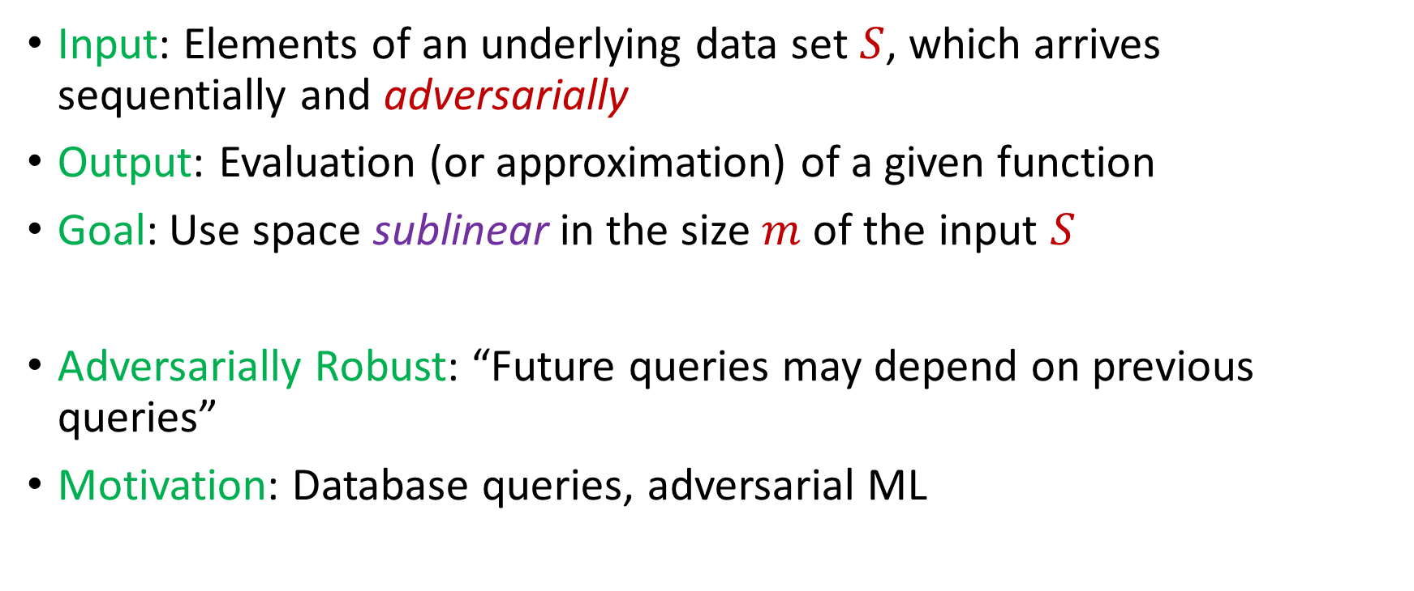
Model #2: Adversarially Robust Streaming
Input: Elements of an underlying data set $S$, which arrives sequentially and adversarially
Output: Evaluation (or approximation) of a given function
Goal: Use space sublinear in the size $m$of the input $S$
Adversarially Robust: “Future queries may depend on previous queries”
Motivation: Database queries, adversarial ML
Notes:
Let’s start by breaking down each of the terms in the title. To understand the sliding window model, we first have to understand the streaming model of computation, in which elements of an underlying data set S, arrive sequentially and the goal is to evaluate or approximate some given function on this dataset, using space sublinear in S. In the sliding window model, only the W most recent updates form the underlying data set

Slide 23
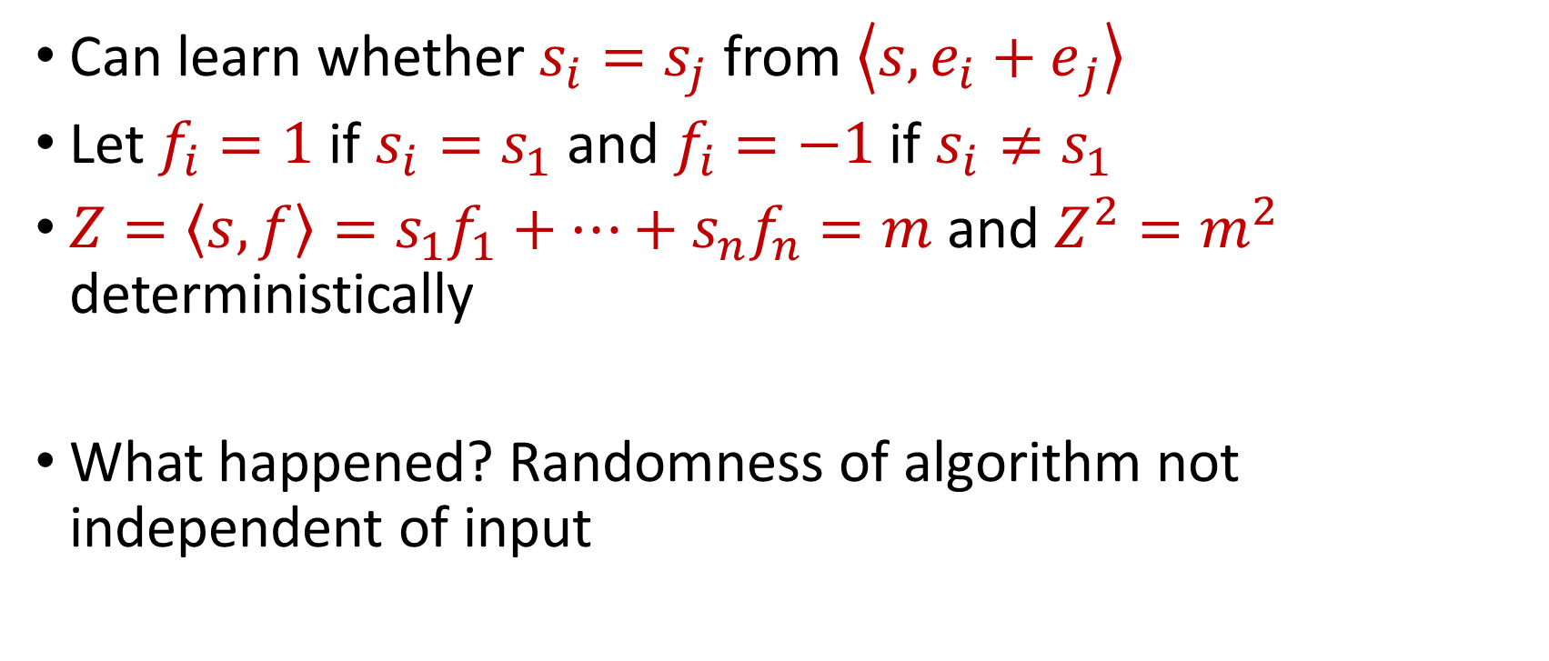
“Attack” on AMS
Can learn whether $s_{i}=s_{j}$ from $\left\langle s,{e_{i}+e}_{j}\right\rangle$
Let $f_{i}=1$ if $s_{i}=s_{1}$ and $f_{i}=−1$ if $s_{i}≠s_{1}$
$Z=\left\langle s,f\right\rangle =s_{1}f_{1}+…+s_{n}f_{n}=m$ and $Z^{2}=m^{2}$ deterministically
What happened? Randomness of algorithm not independent of input

Slide 24
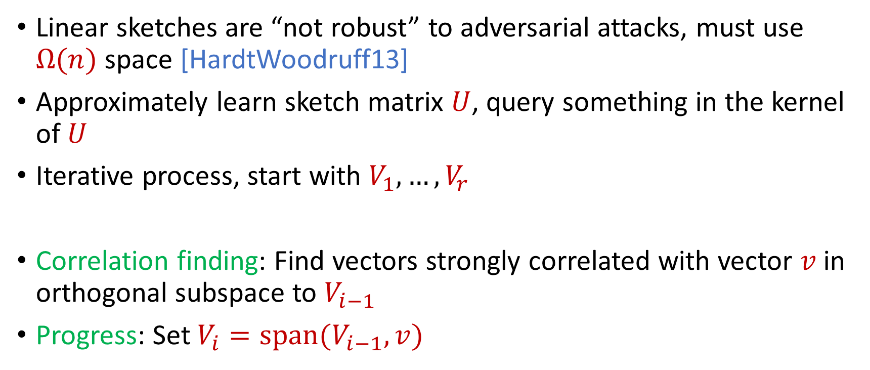
Reconstruction Attack on Linear Sketches
Linear sketches are “not robust” to adversarial attacks, must use $Ω(n)$ space [HardtWoodruff13]
Approximately learn sketch matrix $U$, query something in the kernel of $U$
Iterative process, start with $V_{1},…,V_{r}$
Correlation finding: Find vectors strongly correlated with vector $v$ in orthogonal subspace to $V_{i−1}$
Progress: Set $V_{i}=span(V_{i−1},v)$

Slide 25
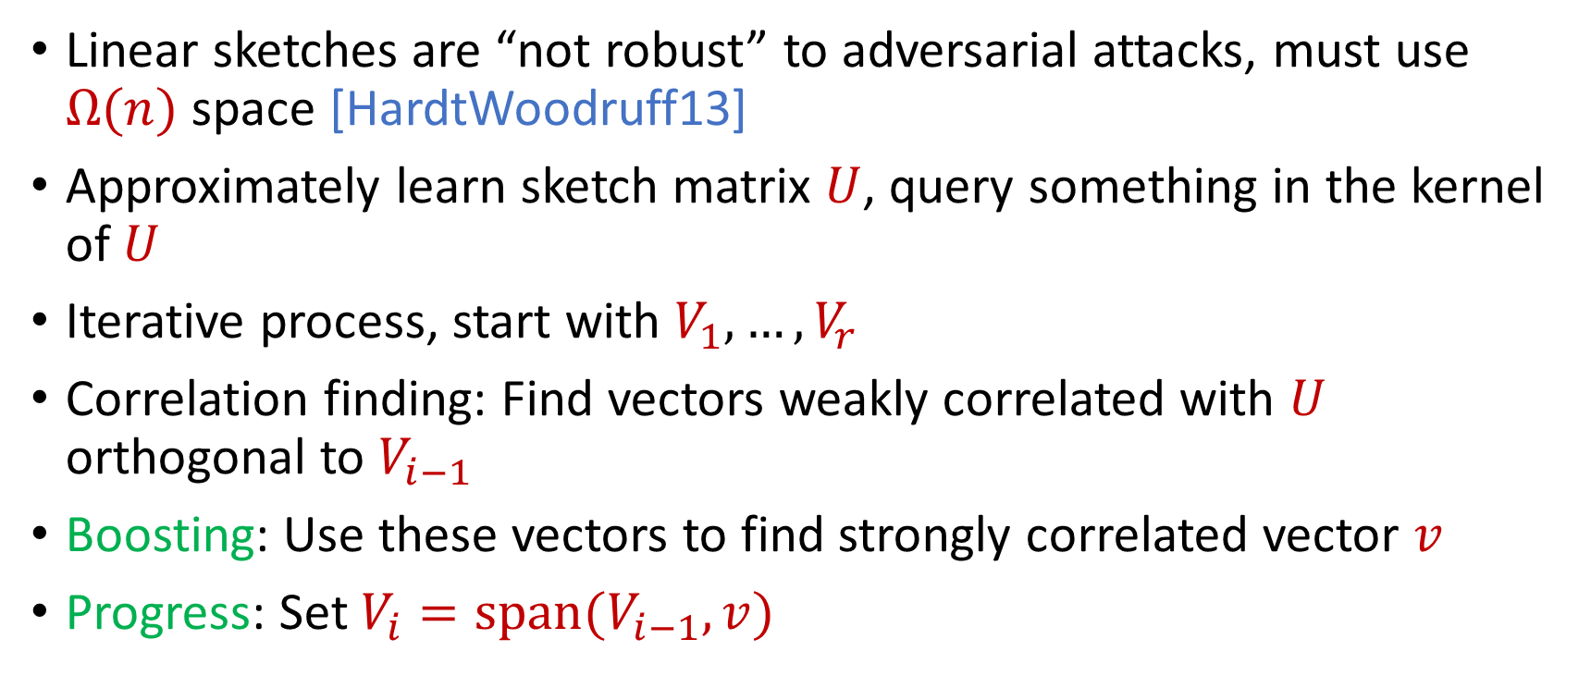
Reconstruction Attack on Linear Sketches
Linear sketches are “not robust” to adversarial attacks, must use $Ω(n)$ space [HardtWoodruff13]
Approximately learn sketch matrix $U$, query something in the kernel of $U$
Iterative process, start with $V_{1},…,V_{r}$
Correlation finding: Find vectors weakly correlated with $U$ orthogonal to $V_{i−1}$
Boosting: Use these vectors to find strongly correlated vector $v$
Progress: Set $V_{i}=span(V_{i−1},v)$

Slide 26
Insertion-Only Streams
Key: Deletions are needed to perform this attack
Assume insertion-only updates
How do the previous results work?

Slide 27
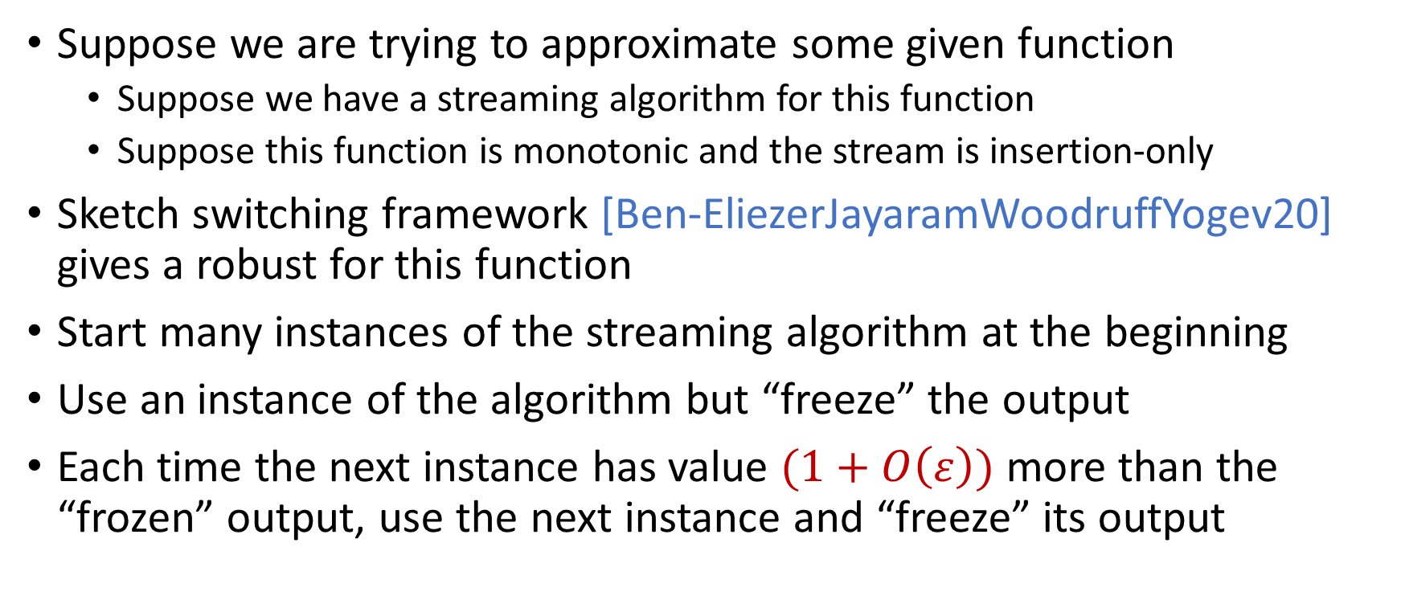
Robust Algorithms
Suppose we are trying to approximate some given function
Suppose we have a streaming algorithm for this function
Suppose this function is monotonic and the stream is insertion-only
Sketch switching framework [Ben-EliezerJayaramWoodruffYogev20] gives a robust for this function
Start many instances of the streaming algorithm at the beginning
Use an instance of the algorithm but “freeze” the output
Each time the next instance has value $(1+O\left(ε\right))$ more than the “frozen” output, use the next instance and “freeze” its output

Slide 28

Sketch Switching
Start many instances of the streaming algorithm at the beginning
Use an instance of the algorithm but “freeze” the output
Each time the next instance has value $(1+O\left(ε\right))$ more than the “frozen” output, use the next instance and “freeze” its output
1
Example: Number of ones in the stream (2-approximation)
1
1
1
1

Slide 29

Sketch Switching
Start many instances of the streaming algorithm at the beginning
Use an instance of the algorithm but “freeze” the output
Each time the next instance has value $(1+O\left(ε\right))$ more than the “frozen” output, use the next instance and “freeze” its output
1 0
Example: Number of ones in the stream (2-approximation)
1
1
1
1

Slide 30
Sketch Switching
Start many instances of the streaming algorithm at the beginning
Use an instance of the algorithm but “freeze” the output
Each time the next instance has value $(1+O\left(ε\right))$ more than the “frozen” output, use the next instance and “freeze” its output
1 0 1
Example: Number of ones in the stream (2-approximation)
1
2
2
2

Slide 31
Sketch Switching
Start many instances of the streaming algorithm at the beginning
Use an instance of the algorithm but “freeze” the output
Each time the next instance has value $(1+O\left(ε\right))$ more than the “frozen” output, use the next instance and “freeze” its output
1 0 1
Example: Number of ones in the stream (2-approximation)
1
2
2
2

Slide 32
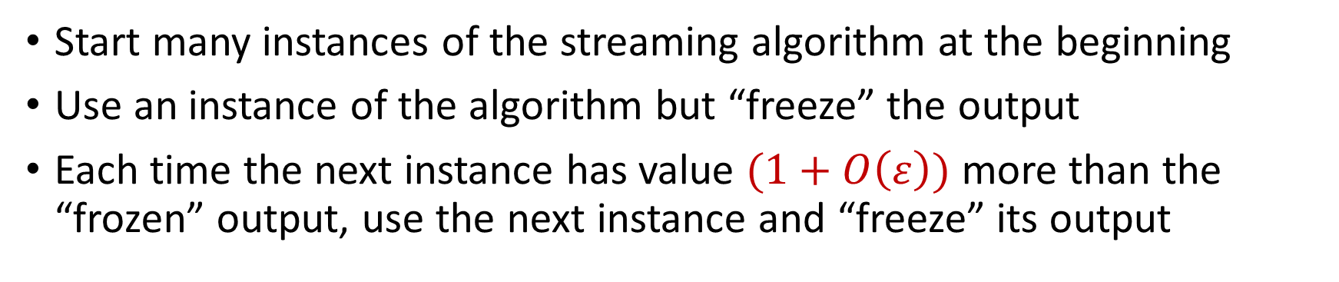
Sketch Switching
Start many instances of the streaming algorithm at the beginning
Use an instance of the algorithm but “freeze” the output
Each time the next instance has value $(1+O\left(ε\right))$ more than the “frozen” output, use the next instance and “freeze” its output
1 0 1 1
Example: Number of ones in the stream (2-approximation)
1
2
3
3

Slide 33
Sketch Switching
Start many instances of the streaming algorithm at the beginning
Use an instance of the algorithm but “freeze” the output
Each time the next instance has value $(1+O\left(ε\right))$ more than the “frozen” output, use the next instance and “freeze” its output
1 0 1 1 1
Example: Number of ones in the stream (2-approximation)
1
2
4
4

Slide 34
Sketch Switching
Start many instances of the streaming algorithm at the beginning
Use an instance of the algorithm but “freeze” the output
Each time the next instance has value $(1+O\left(ε\right))$ more than the “frozen” output, use the next instance and “freeze” its output
1 0 1 1 1
Example: Number of ones in the stream (2-approximation)
1
2
4
4

Slide 35
Sketch Switching
Start many instances of the streaming algorithm at the beginning
Use an instance of the algorithm but “freeze” the output
Each time the next instance has value $(1+O\left(ε\right))$ more than the “frozen” output, use the next instance and “freeze” its output
1 0 1 1 1 0 0 1 1 0 1
Example: Number of ones in the stream (2-approximation)
Number of ones stream is at least 4 and at most 8
4 is a good approximation
1
2
4
7

Slide 36
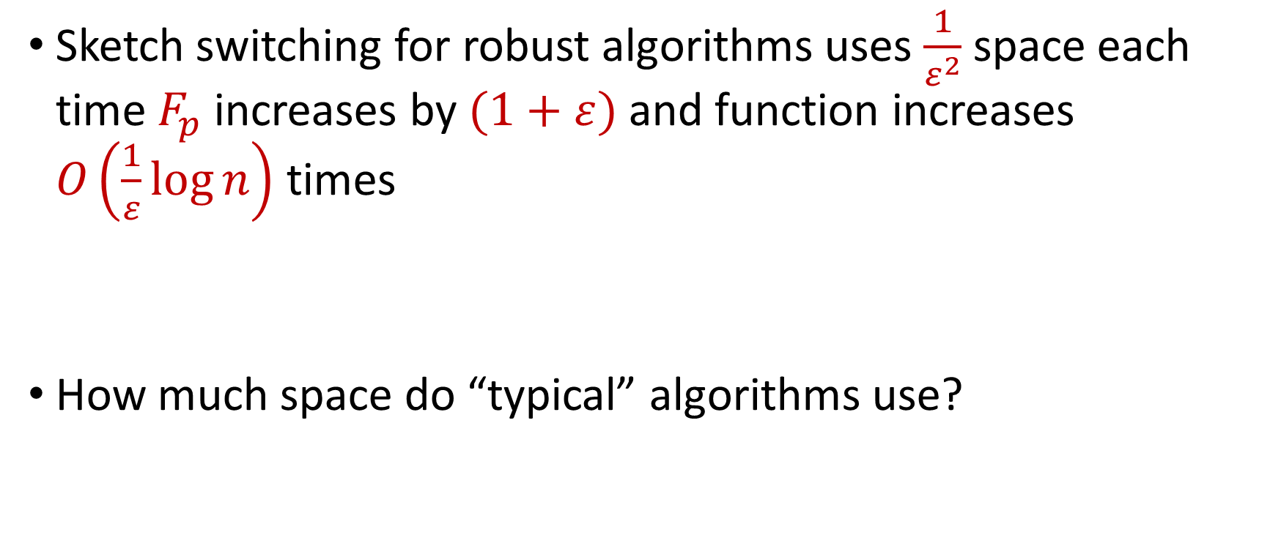
Sketch Switching Summary
Sketch switching for robust algorithms uses $\frac{1}{ε^{2}}$ space each time $F_{p}$ increases by $(1+ε)$ and function increases $O\left(\frac{1}{ε}\log{n}\right)$ times
How much space do “typical” algorithms use?

Slide 37
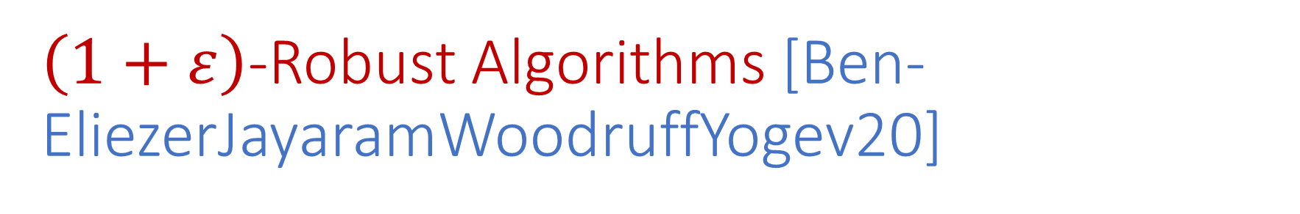
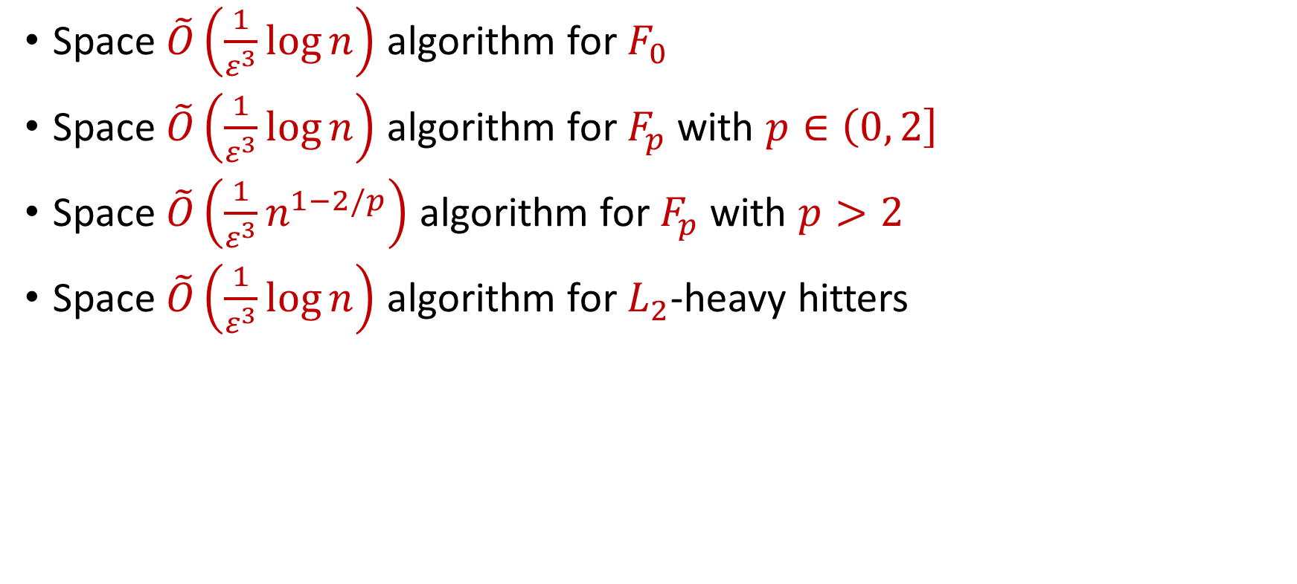
$\left(1+ε\right)$-Robust Algorithms [Ben-EliezerJayaramWoodruffYogev20]
Space $\tilde{O}\left(\frac{1}{ε^{3}}\log{n}\right)$ algorithm for $F_{0}$
Space $\tilde{O}\left(\frac{1}{ε^{3}}\log{n}\right)$ algorithm for $F_{p}$ with $p∈\left(0, 2\right]$
Space $\tilde{O}\left(\frac{1}{ε^{3}}n^{1−2/p}\right)$ algorithm for $F_{p}$ with $p>2$
Space $\tilde{O}\left(\frac{1}{ε^{3}}\log{n}\right)$ algorithm for $L_{2}$-heavy hitters
“A general framework that loses* nothing in $n$ and only $\frac{1}{ε}$ ”

Slide 38
Computation Paths
Upper bound the number of total possible inputs
Union bound over all of these inputs

Slide 39
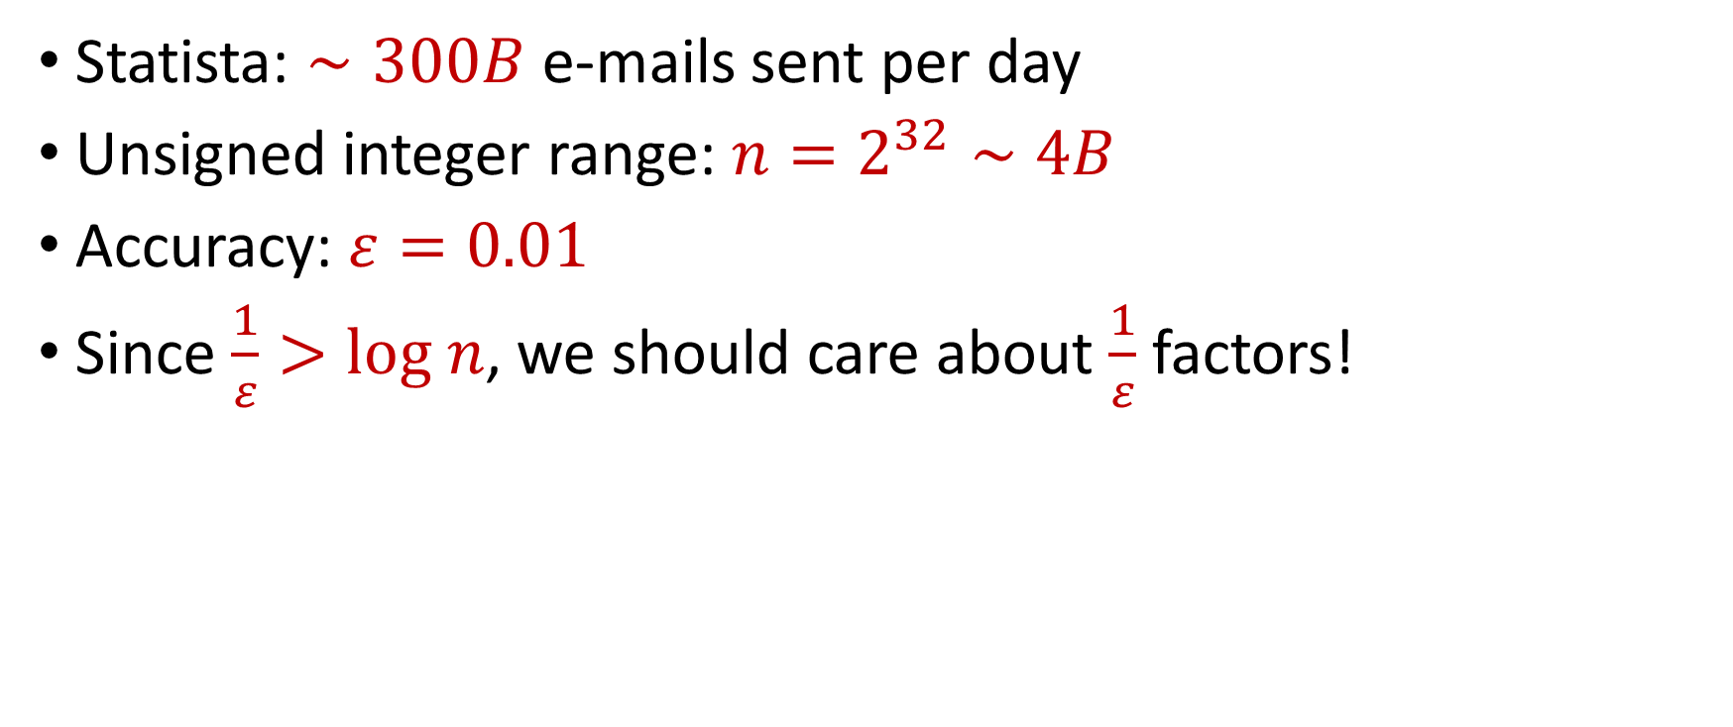
“What’s an epsilon between friends?
Statista: $∼300B$ e-mails sent per day
Unsigned integer range: $n=2^{32}∼4B$
Accuracy: $ε=0.01$
Since $\frac{1}{ε}>log n$, we should care about $\frac{1}{ε}$ factors!

Slide 40




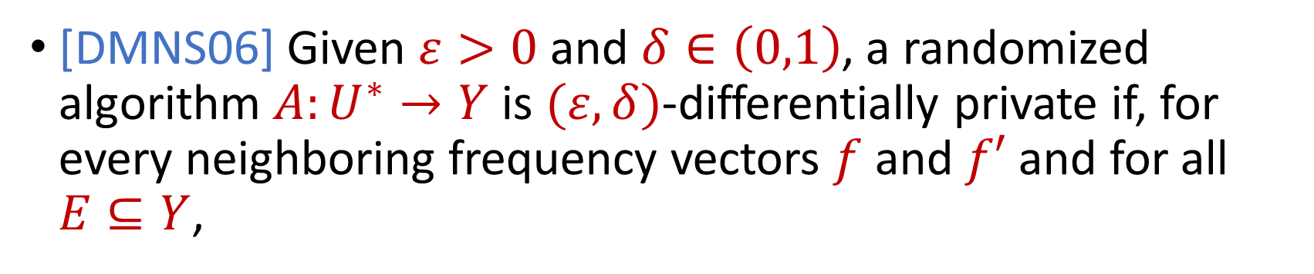

Differential Privacy
[DMNS06] Given $ε>0$and $δ∈\left(0,1\right)$, a randomized algorithm $A:U^{∗}→Y$ is $(ε,δ)$-differentially private if, for every neighboring frequency vectors $f$ and $f′$ and for all $E⊆Y$,
$$Pr\left[A\left(f\right)∈E\right]≤e^{ε}Pr\left[A\left(f^{′}\right)∈E\right]+δ$$
$$A\left( \right)≈A\left( \right)$$
Notes:
[DworkMcSherryNissimSmith06]

Slide 41
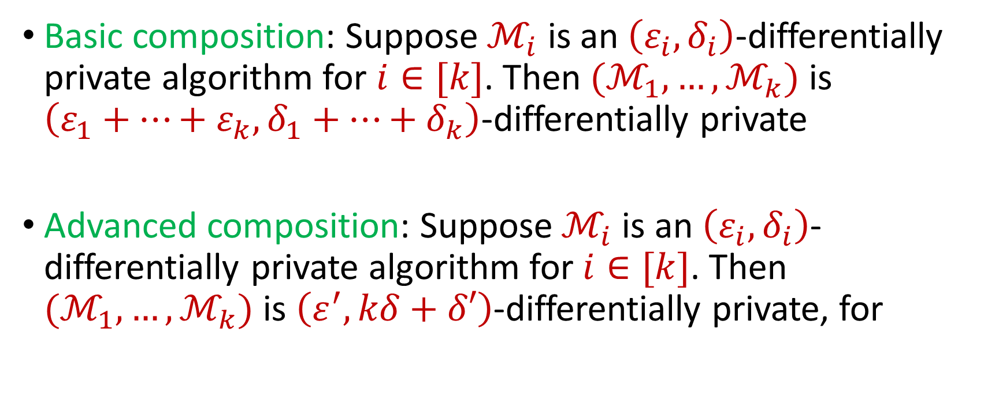
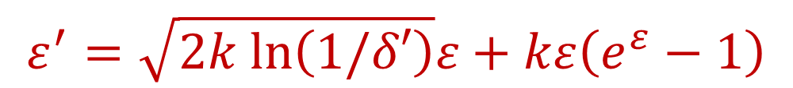
Composition Theorems
Basic composition: Suppose $ℳ_{i}$ is an $\left(ε_{i},δ_{i}\right)$-differentially private algorithm for $i∈[k]$. Then $(ℳ_{1},…,ℳ_{k})$ is $\left(ε_{1}+…+ε_{k},δ_{1}+…+δ_{k}\right)$-differentially private
Advanced composition: Suppose $ℳ_{i}$ is an $\left(ε_{i},δ_{i}\right)$-differentially private algorithm for $i∈[k]$. Then $(ℳ_{1},…,ℳ_{k})$ is $\left(ε^{′},kδ+δ′\right)$-differentially private, for
$$ε^{′}=\sqrt{2k ln\left(1/δ′\right)}ε+kε\left(e^{ε}−1\right)$$
Notes:
[DworkMcSherryNissimSmith06]

Slide 42
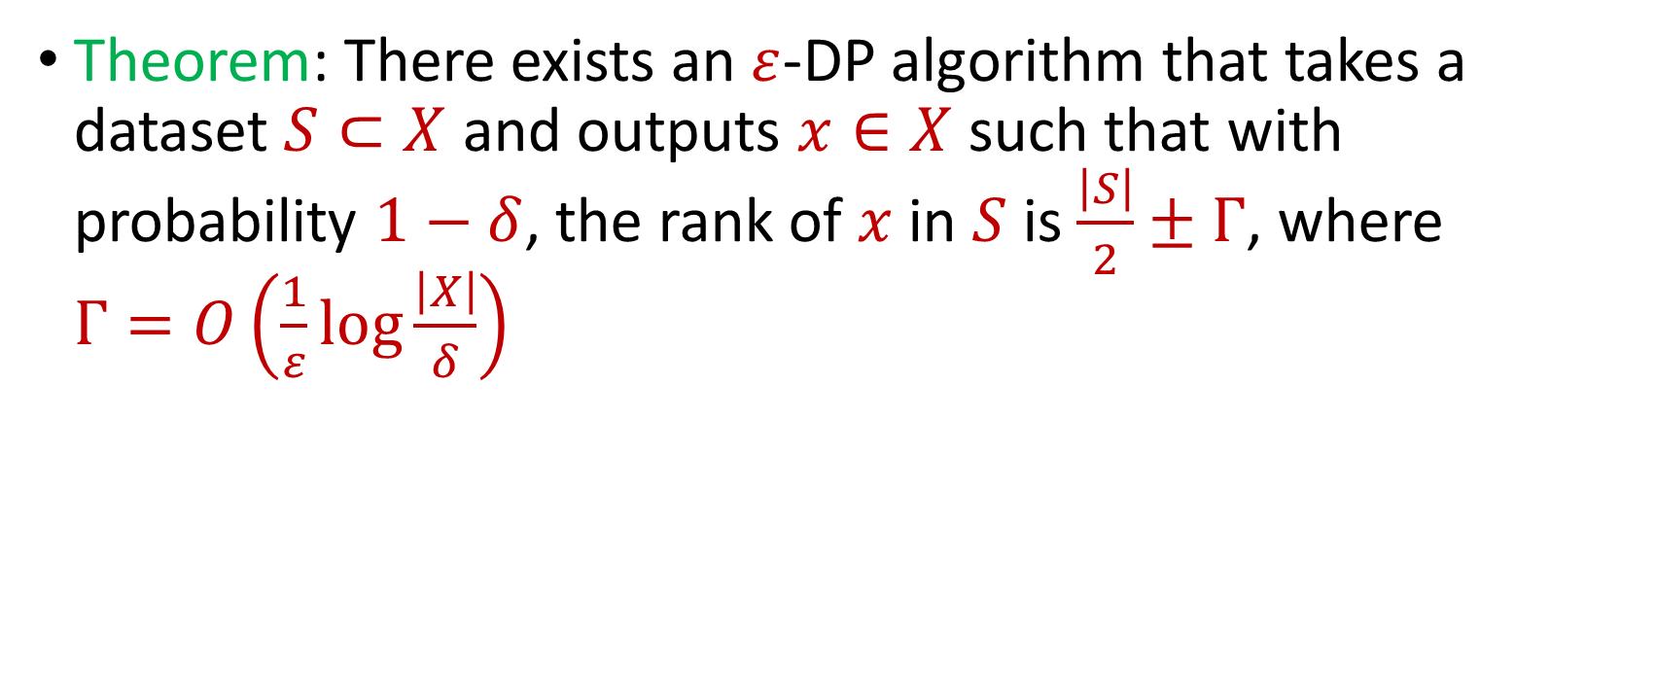
Private Median
Theorem: There exists an $ε$-DP algorithm that takes a dataset $S⊂X$ and outputs $x∈X$ such that with probability $1−δ$, the rank of $x$ in $S$ is $\frac{\left|S\right|}{2}±Γ$, where $Γ=O\left(\frac{1}{ε}\log{\frac{\left|X\right|}{δ}}\right)$
Notes:
[DworkMcSherryNissimSmith06]

Slide 43
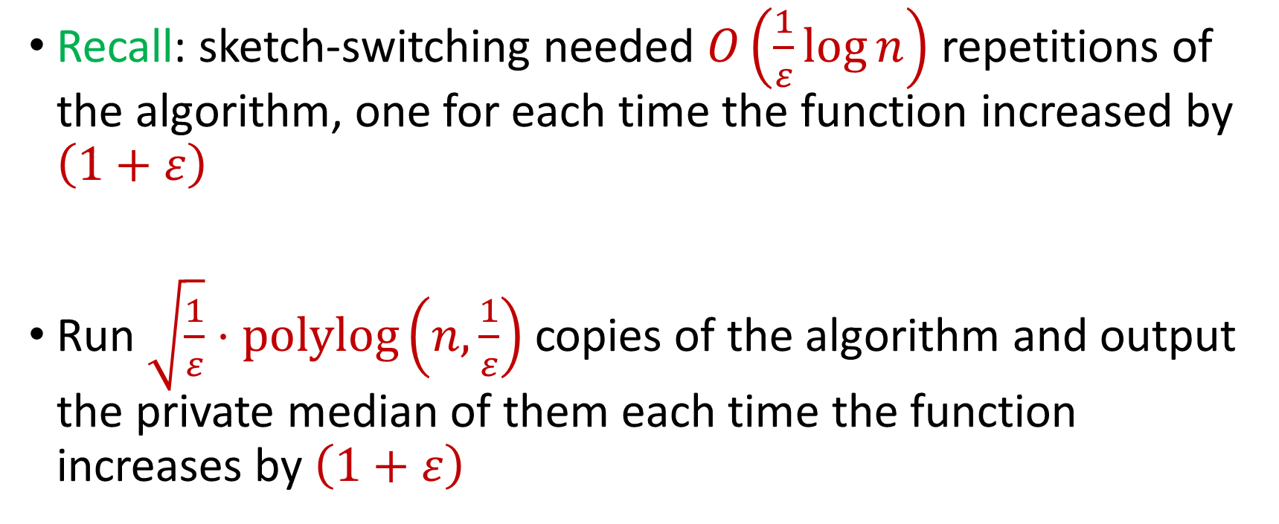
DP for Adversarial Robustness
Recall: sketch-switching needed $O\left(\frac{1}{ε}\log{n}\right)$ repetitions of the algorithm, one for each time the function increased by $\left(1+ε\right)$
Run $\sqrt{\frac{1}{ε}}⋅polylog\left(n,\frac{1}{ε}\right)$ copies of the algorithm and output the private median of them each time the function increases by $\left(1+ε\right)$
Notes:
[DworkMcSherryNissimSmith06]

Slide 44
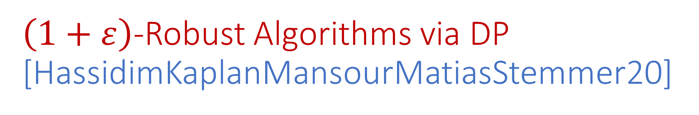
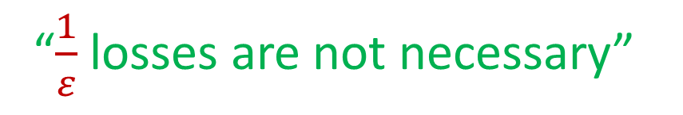
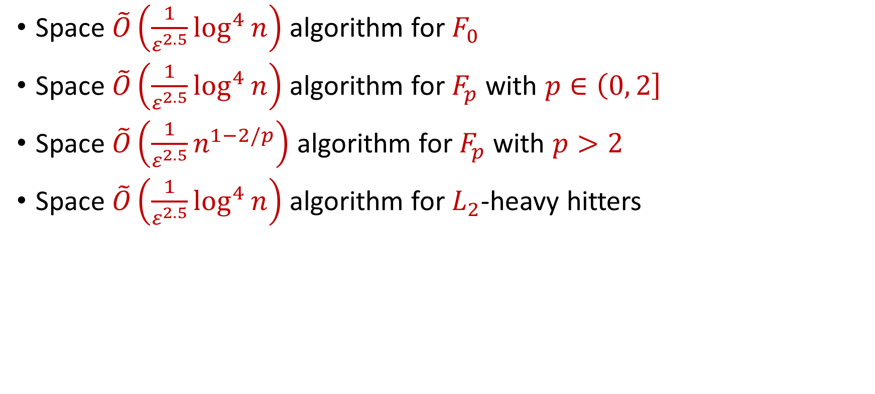
$\left(1+ε\right)$-Robust Algorithms via DP [HassidimKaplanMansourMatiasStemmer20]
Space $\tilde{O}\left(\frac{1}{ε^{2.5}}\log^{4}{n}\right)$ algorithm for $F_{0}$
Space $\tilde{O}\left(\frac{1}{ε^{2.5}}\log^{4}{n}\right)$ algorithm for $F_{p}$ with $p∈\left(0, 2\right]$
Space $\tilde{O}\left(\frac{1}{ε^{2.5}}n^{1−2/p}\right)$ algorithm for $F_{p}$ with $p>2$
Space $\tilde{O}\left(\frac{1}{ε^{2.5}}\log^{4}{n}\right)$ algorithm for $L_{2}$-heavy hitters
“$\frac{1}{ε}$ losses are not necessary”

Slide 45
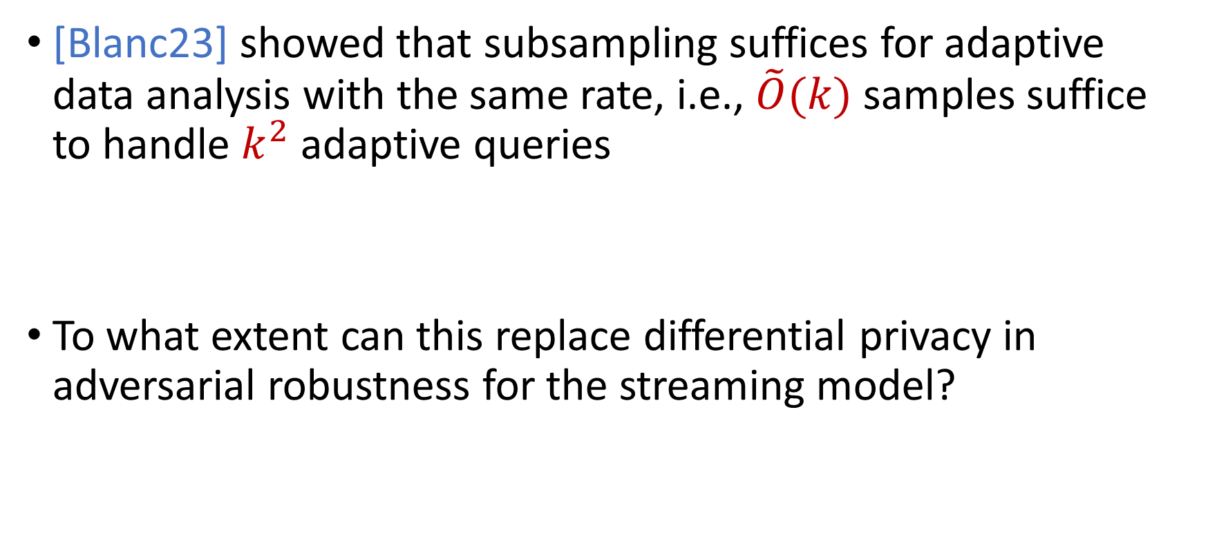
A Curious Question…
[Blanc23] showed that subsampling suffices for adaptive data analysis with the same rate, i.e., $\tilde{O}(k)$ samples suffice to handle $k^{2}$ adaptive queries
To what extent can this replace differential privacy in adversarial robustness for the streaming model?

Slide 46
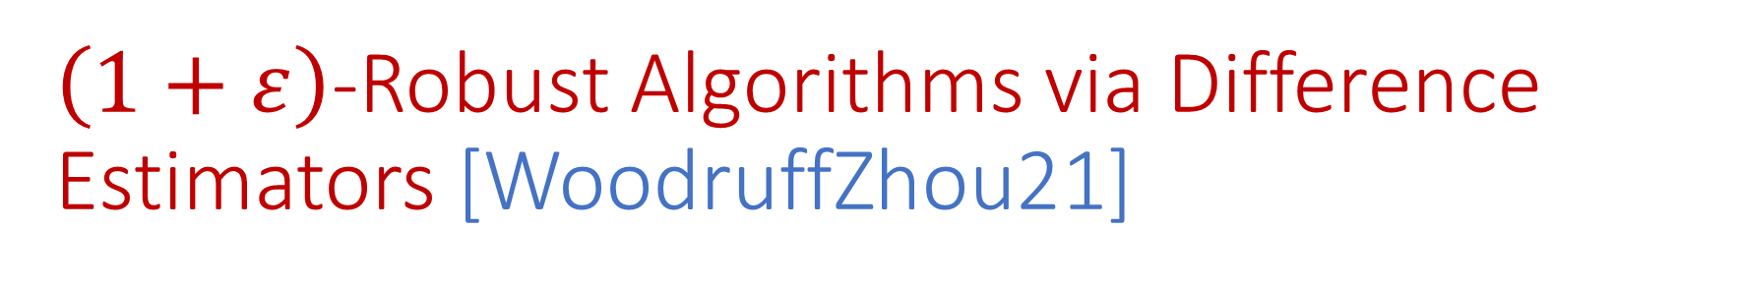
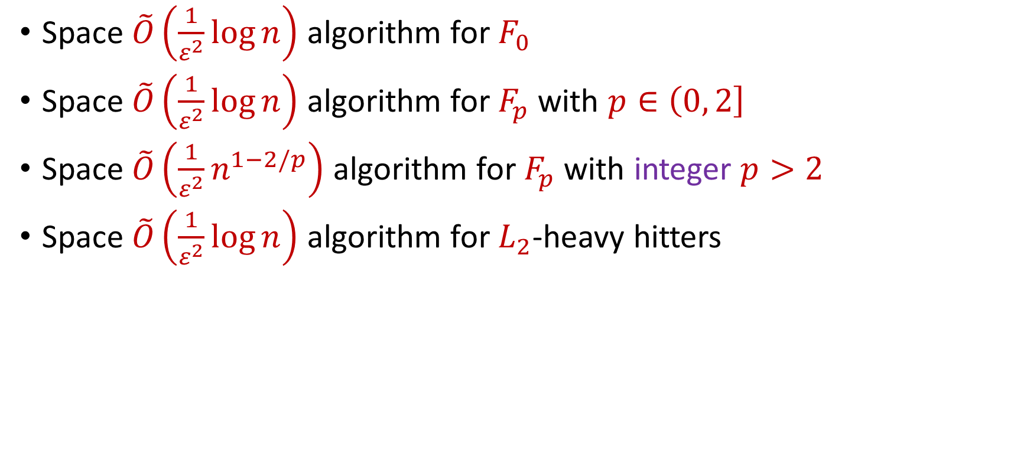
$\left(1+ε\right)$-Robust Algorithms via Difference Estimators [WoodruffZhou21]
Space $\tilde{O}\left(\frac{1}{ε^{2}}\log{n}\right)$ algorithm for $F_{0}$
Space $\tilde{O}\left(\frac{1}{ε^{2}}\log{n}\right)$ algorithm for $F_{p}$ with $p∈\left(0, 2\right]$
Space $\tilde{O}\left(\frac{1}{ε^{2}}n^{1−2/p}\right)$ algorithm for $F_{p}$ with integer $p>2$
Space $\tilde{O}\left(\frac{1}{ε^{2}}\log{n}\right)$ algorithm for $L_{2}$-heavy hitters
“No losses* are necessary!”

Slide 47


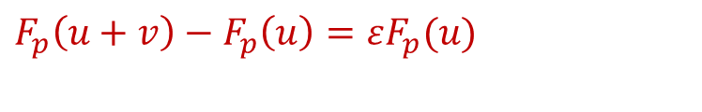




Difference Estimators Intuition
Do not need to pay $\frac{1}{ε^{2}}$ space each time $F_{p}$ increases by $(1+ε)$?
Only need constant factor approximation to $εF_{p}(u)$
Only need constant factor approximation to $F_{p}\left(u+v\right)−F_{p}\left(u\right)$
$F_{p}(u)$
Use difference estimator
$$u$$
$$u+v$$
$F_{p}\left(u+v\right)−F_{p}\left(u\right)=εF_{p}(u)$
$F_{p}(u+v)$
$$v$$

Slide 48
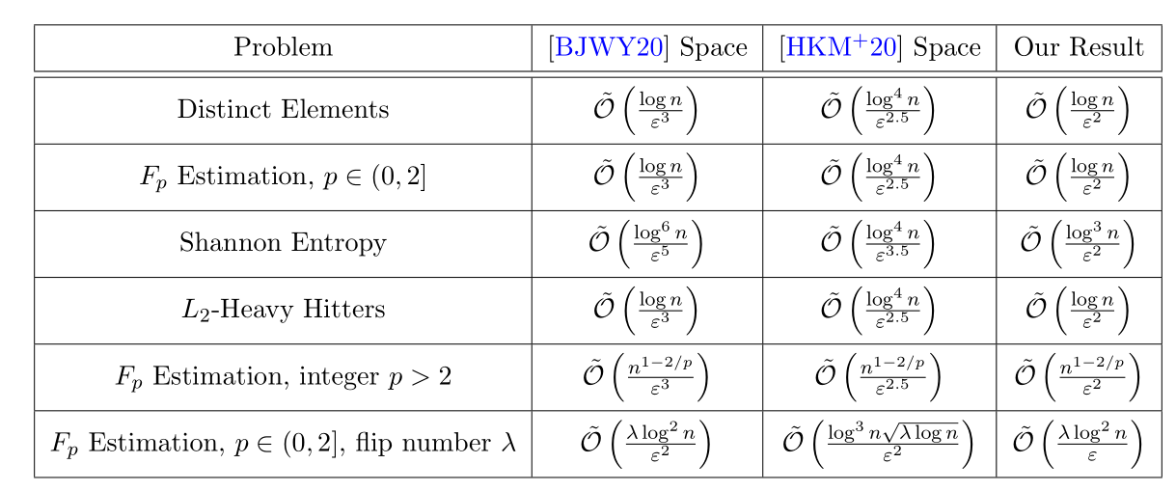
Summary

Slide 49
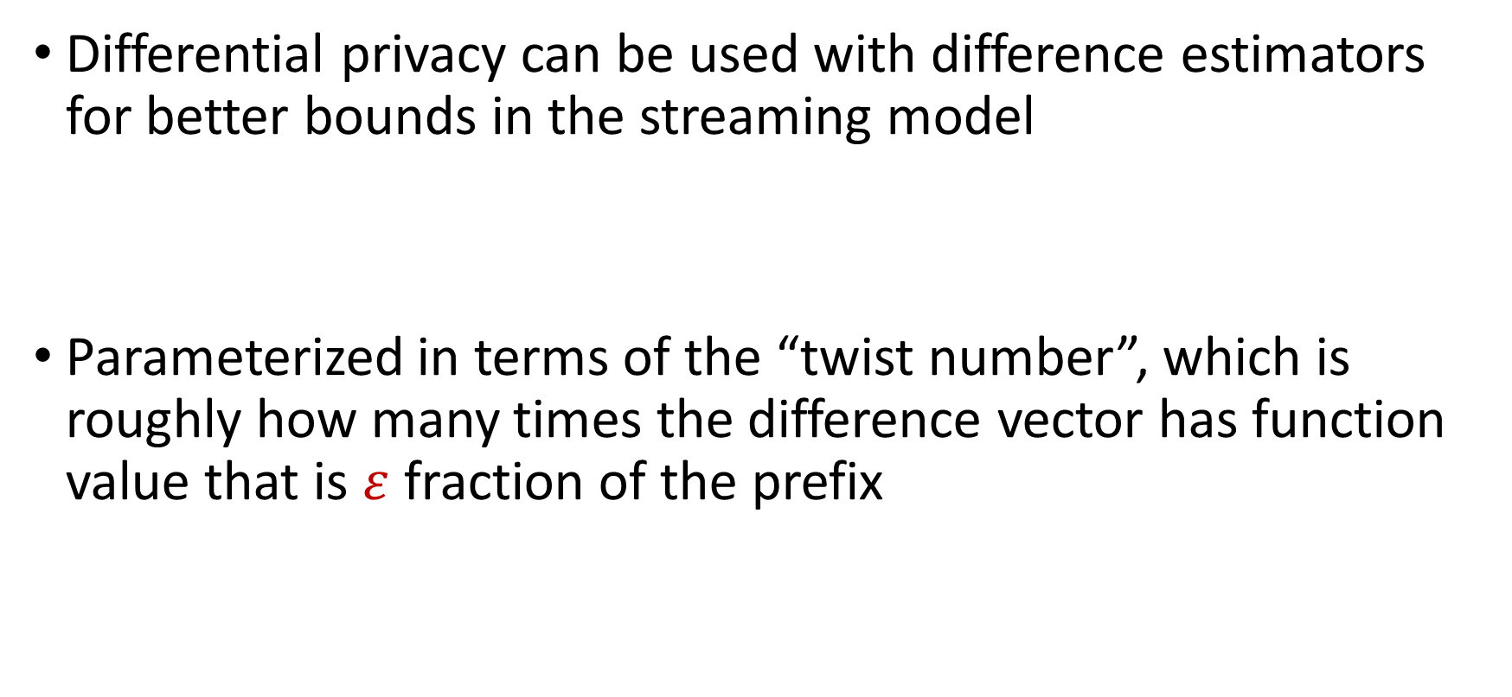
DP Strikes Back [AttiasCohenShechnerStemmer23]
Differential privacy can be used with difference estimators for better bounds in the streaming model
Parameterized in terms of the “twist number”, which is roughly how many times the difference vector has function value that is $ε$ fraction of the prefix

Slide 50
White-Box Adversaries
The adversary has access not only to the previous outputs of the honest algorithm, but also to the entire internal state of the algorithm
Certain sampling algorithms are robust even to white-box adversaries [BravermanHassidimMattiasSchainSilwalZhou22]
Can use crypto against time-bounded white-box adversaries

Slide 51
Many Other Beautiful Works

Slide 52
Future Directions
Capabilities and limitations for insertion-deletion streams?
Refining adversary models and interactions, e.g., computationally restricted adversaries (bounded time, space , etc.), delayed observations, partial visibility of randomness
Adversarial input in other models, e.g., distributed monitoring, MPC

Slide 53


Any Questions?

